Slide 1
Reproducible big data analytics: the EGI solution
PaNOSC Annual Meeting
Trieste, Nov. 04-05, 2019
Giuseppe La Rocca
EGI Foundation

Slide 2
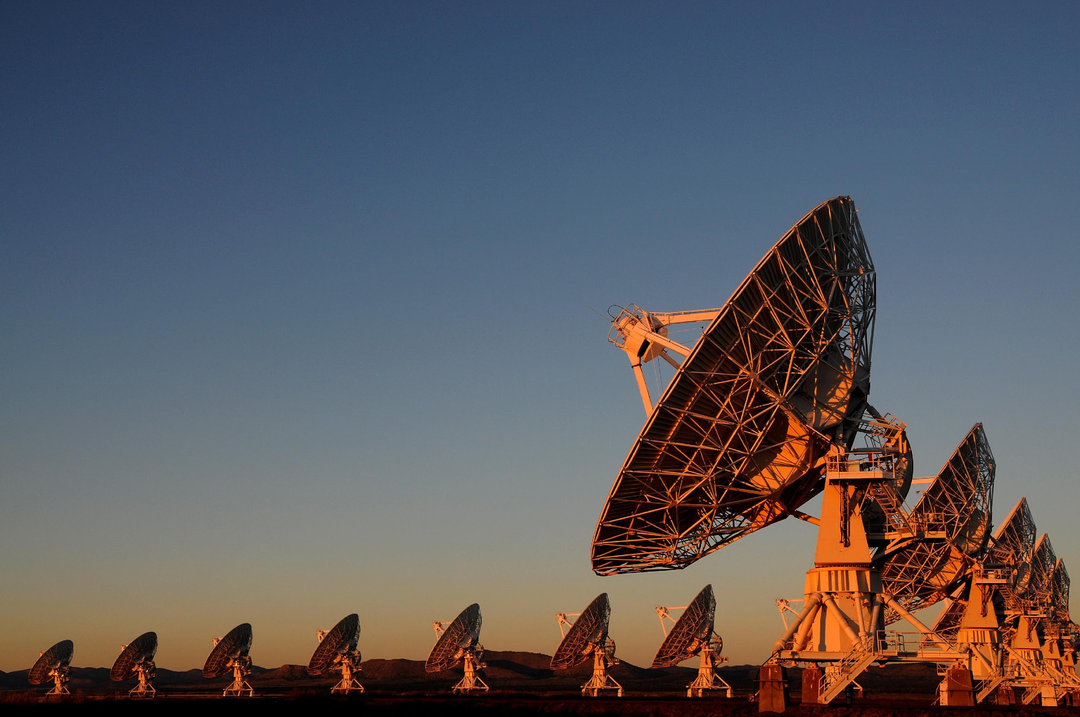
EGI is a federation of over 200 computing and data centres spread across Europe and the rest of the world
To deliver advanced computing services for research
47 Countries 71,000 users | 12 Integrated e-Infrastructures 1,700 Open Access Publications in 2018 | 31 large-scale research collaborations 20+ business use cases

Slide 3
Open Science
Open science is the movement to make scientific research and its dissemination accessible to all levels of an inquiring society, amateur or professional.
Publications, data, physical samples, and software
A continuation of, rather than a revolution in research practices
An important approach to increase the reproducibility of research
Benefits: increased science output; lower costs; reproducibility;
Jupyter Notebooks, Virtualisation/containerisation, Open Access data repositories provide new foundation for open science

Slide 4
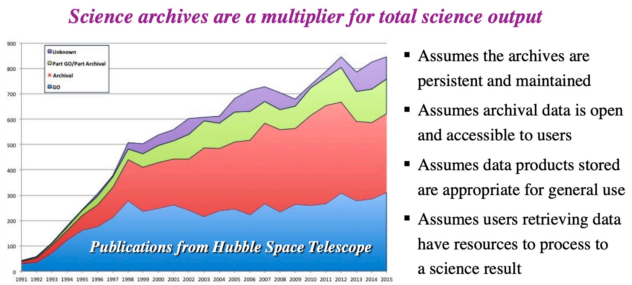
Motivation: Increased science output
Publications from science archive data

Slide 5
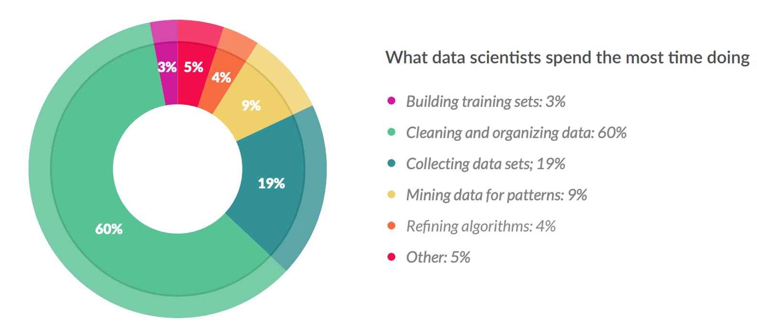
Motivation: Financial
Less than 20% !
Source: CloudFlower data sceince report 2016 https://visit.figure-eight.com/rs/416-ZBE-142/images/CrowdFlower_DataScienceReport_2016.pdf

Slide 6
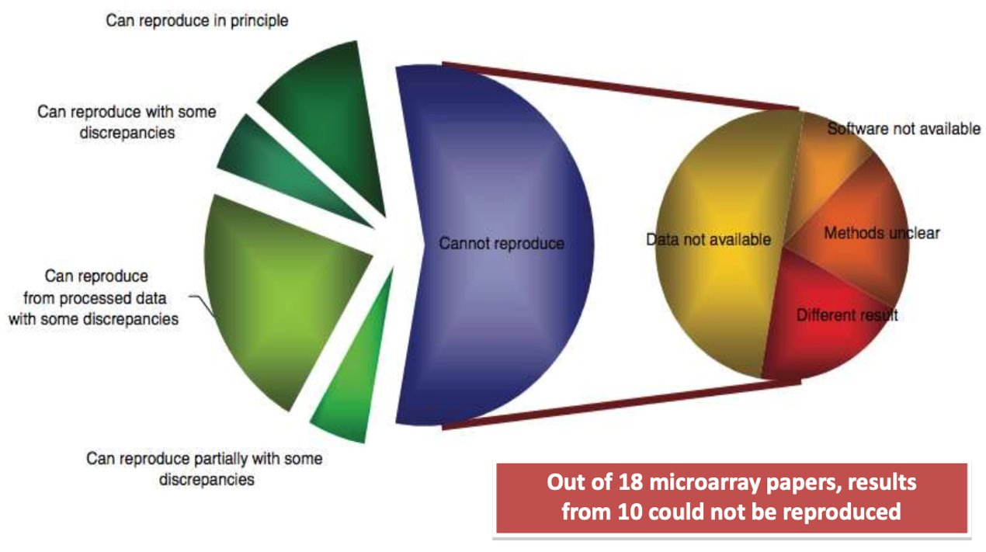
Motivation: Reproducibility
Source: Ioannidis et al., 2009. Repeatability of published microarray gene expression analyses. Nature Genetics 41: 14

Slide 7
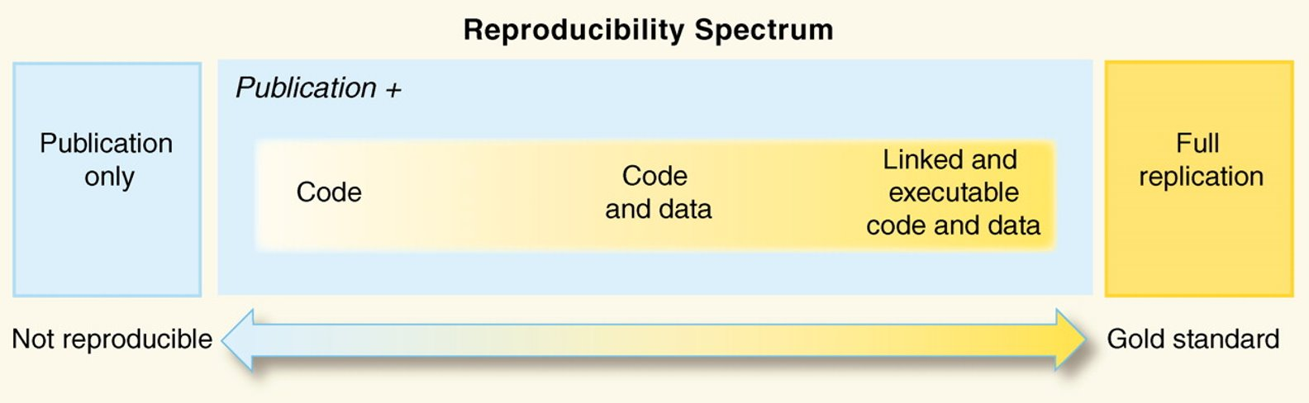
Reproducibility: beyond sharing code and data
Peng, Science, 2011

Slide 8




Reproducibly Open Science
The computational tools to solve a problem
Python, R, Julia, and wide ecosystem of libraries and tools for science
An interface to facilitate coding/creating
Jupyter
A way to communicate your work
Notebooks
Leverage on the EGI Cloud to scale-up the resources
Connect with DataHub to have a transparent data access
A way to share your work
GitHub, Zenodo or other similar repositories
A way to pack it all for replication
Docker (used by Binder)
A way to persistently identify it
DOIs (Digital Object Identifiers)
EGI DataHub (powered by Onedata software)
binder

Slide 9

Introduction of technologies & the features that contributes to Open Science: GitHub, Zenodo, Onedata, Jupyter notebooks and Binder
EGI DataHub (powered by Onedata software)

Slide 10


Git and GitHub
Git is an open-source distributed version-control system
Written to manage development of Linux
Tracks and manages source code over time
GitHub is a social network for software development
Git repository hosting service + extra features
GitHub provides a web-based interface on top of git.
Collaboration features: access control, wikis, issues, projects, …
Social network for software development.
Connected with Zenodo:
Got a DOI from a GitHub repo

Slide 11
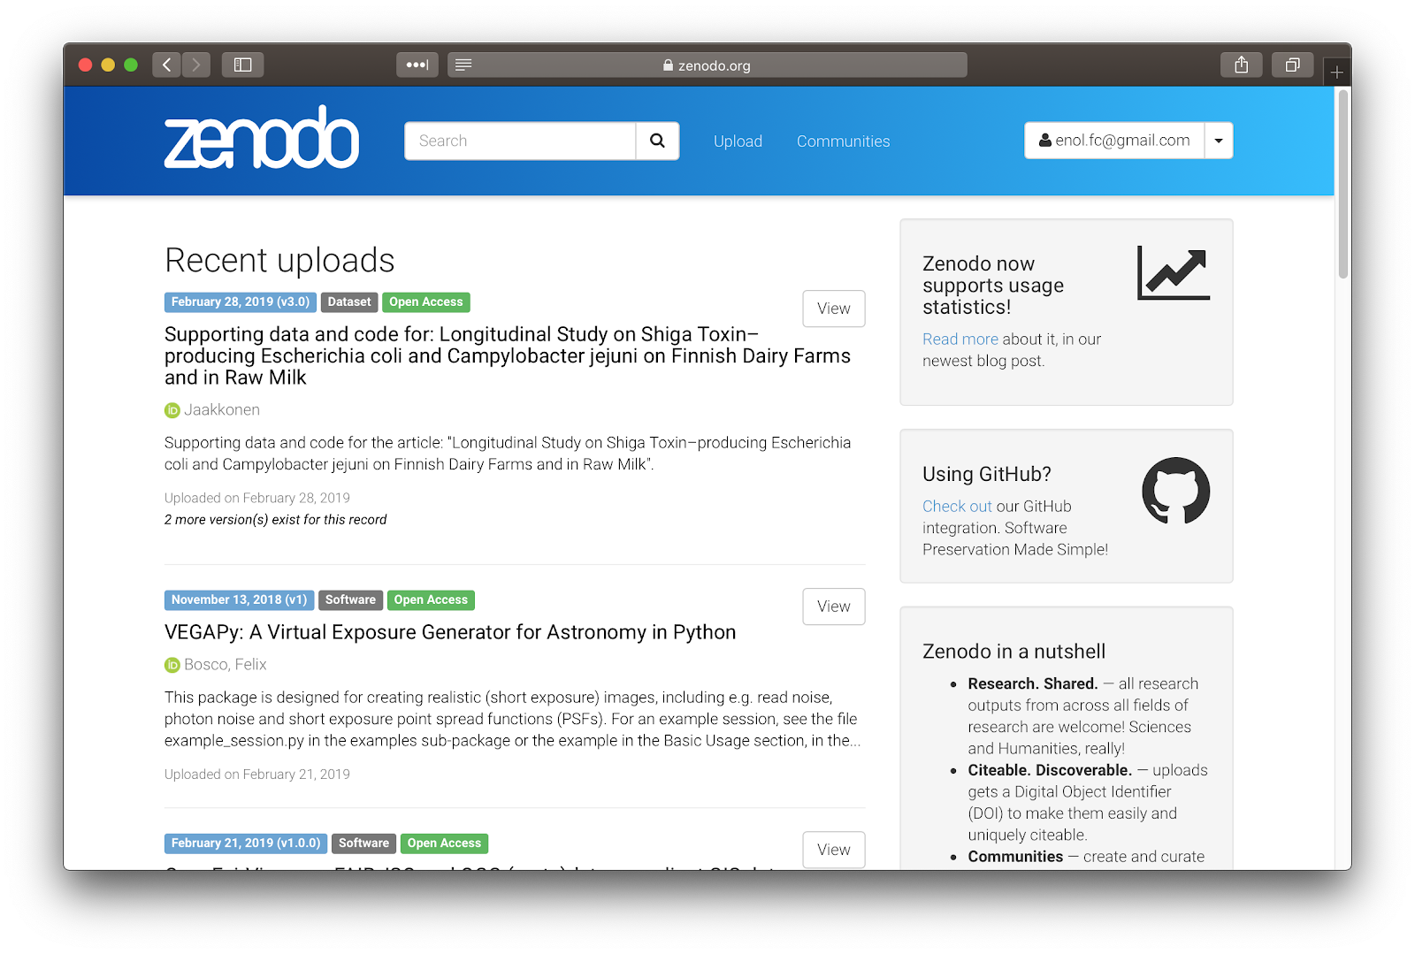

Zenodo - https://zenodo.org
‘Open Science’ repository from OpenAIRE
Hosted at CERN data centre
For
Publications, white papers, datasets, software, etc.
For
Long-tail science
Projects
Communities
Research groups
Dropbox, GitHub integration: - Web or API access
Access stats and reports for communities

Slide 12
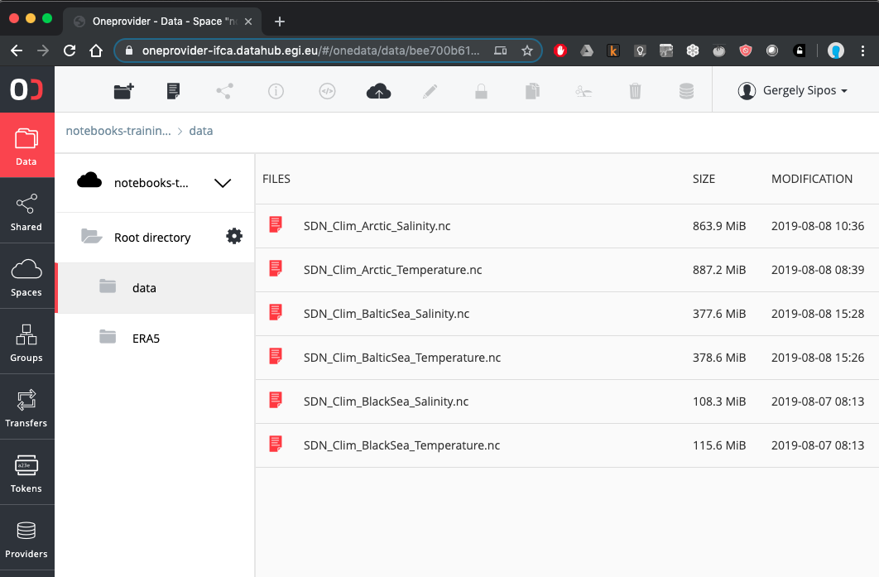
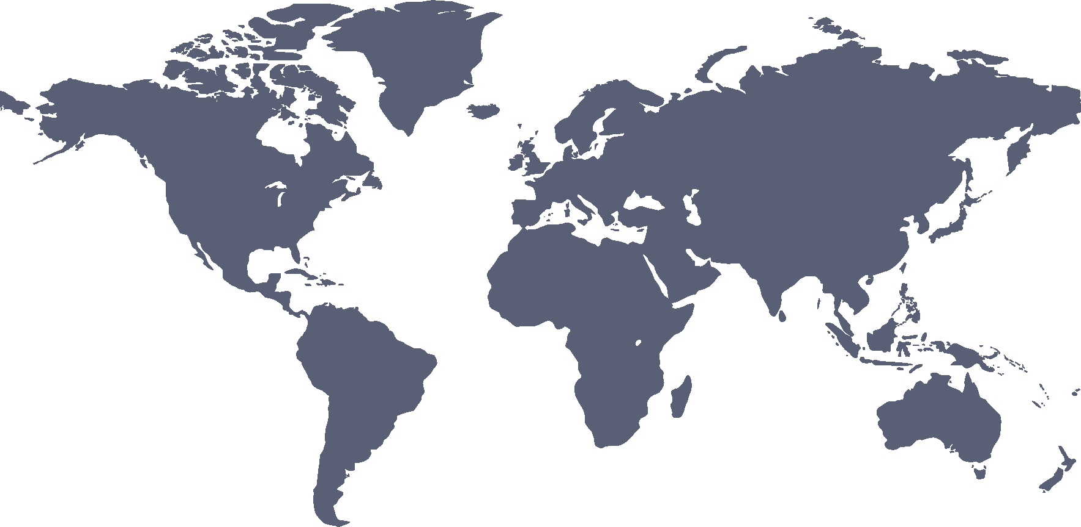



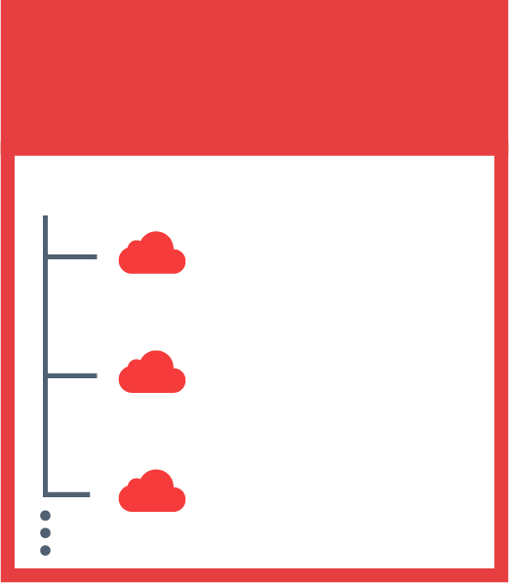

EGI DataHub - https://datahub.egi.eu
Virtual, global file systems
A provider: Physical storage for files
JOHN’S SPACES
SENTINEL 2
DEEP LEARNING
SARA’S SPACES
PUBLICATIONS
A space: Hierarchical organisation of files. (Directory structure)
SENTINEL 2
SKY MAPS
MY DATA

Slide 13
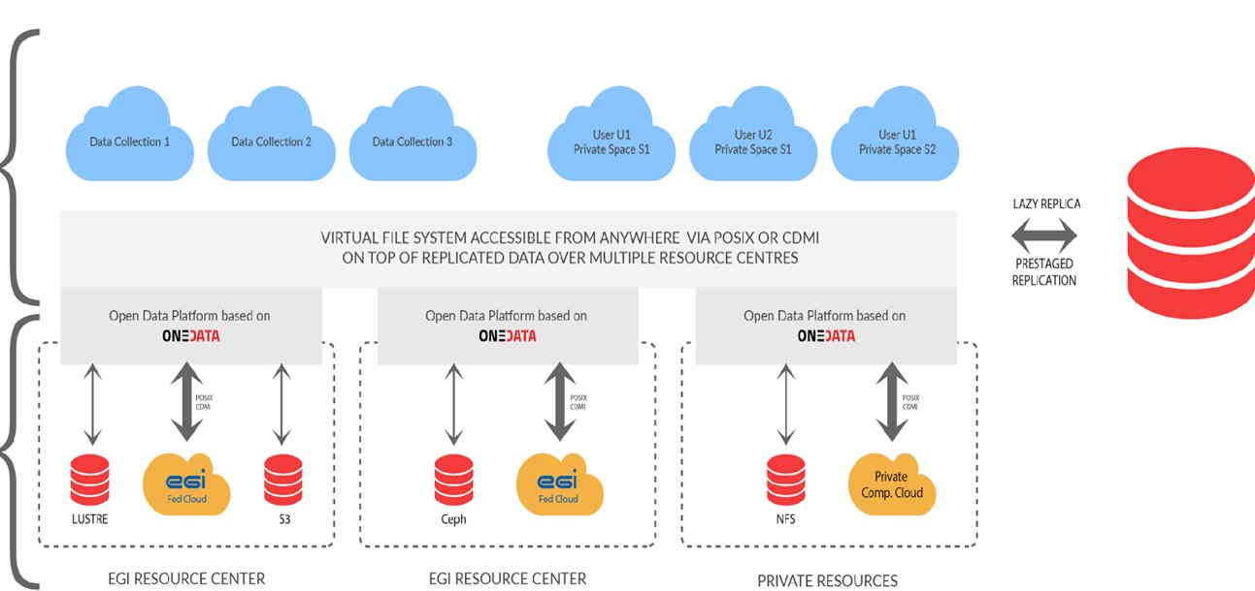
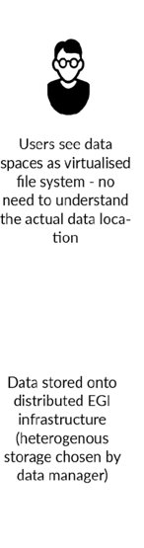

Accessing federated data with Notebooks
EGI Notebooks
EGI Binder

Slide 14
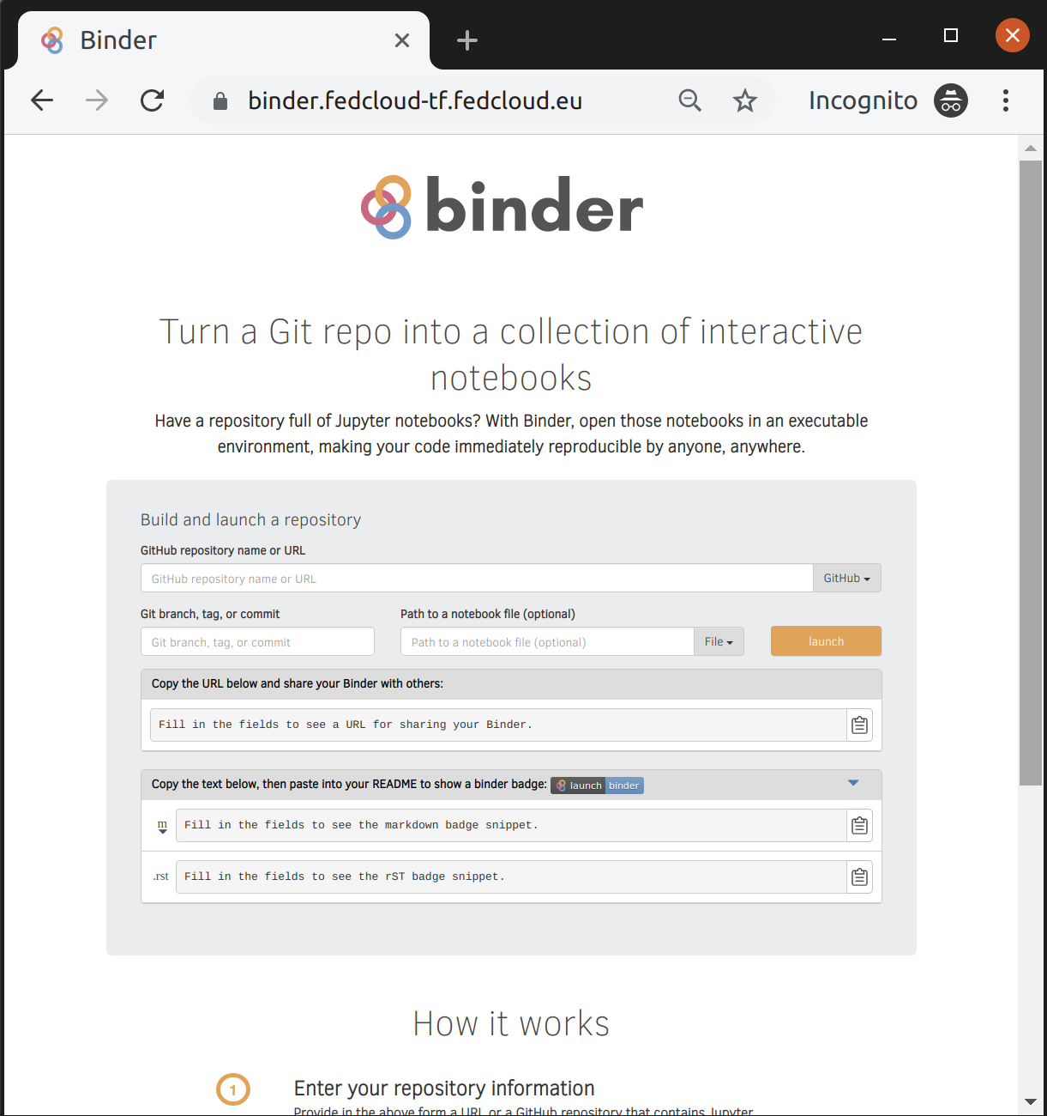
EGI Binder service
https://binder.fedcloud-tf.fedcloud.eu
The service is available in Alpha mode for restricted users
Notebooks to reply in the service are limited to 1 CPU, 1GB RAM and 10GB of persistent storage per user
Production version is planned to be opened in late 2019

Slide 15
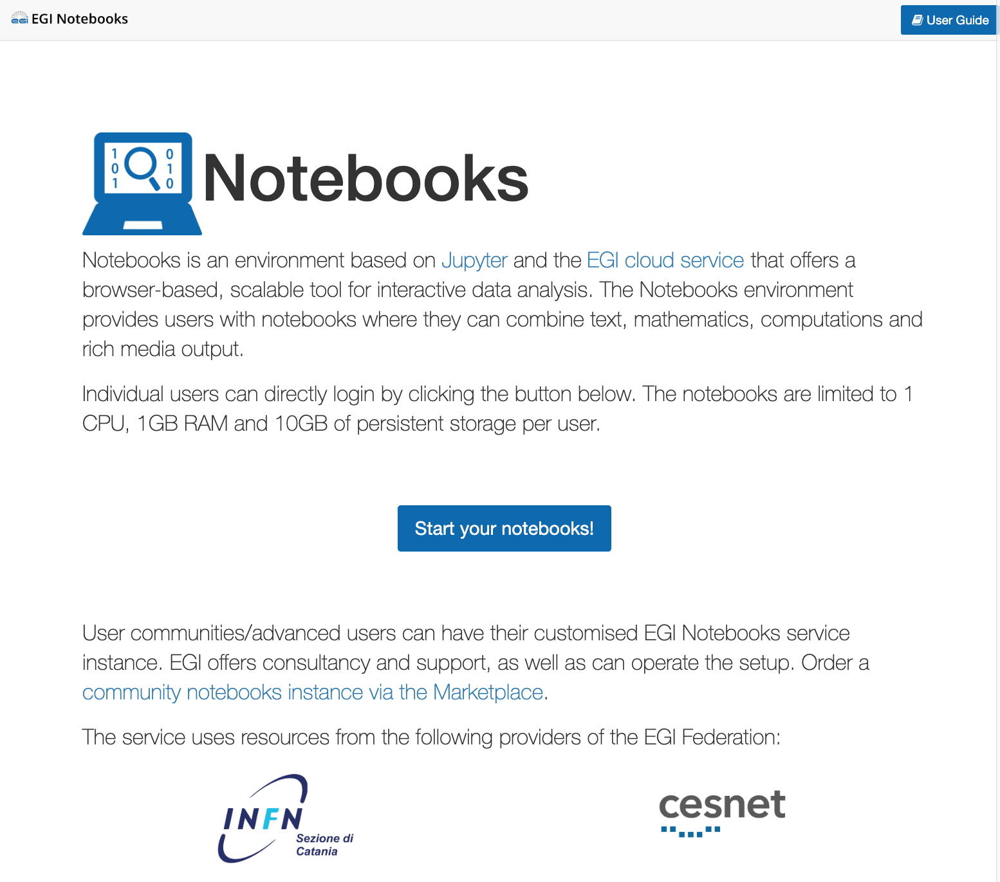
EGI Notebooks
User guide
https://notebooks.egi.eu
Start from JupyterHub
Multi-user server to spawn single-users' notebooks
Support community libraries and kernels
Host on the EGI Clouds 🡪 Scalable computing
Allocate CPUs from a single site
Setup Notebooks on multiple sites (or in cloud with bigger VMs)
Connect with DataHub 🡪 Scalable data access
Distributed file system for I/O
Present datasets as local directories in Jupyter
Assign DOIs (Alpha)
DOI for the Notebook
DOI for the data used by the Notebook
Setup Binder (Alpha)
One-click replay of a Notebooks and data
Login
🡪 Reproducibility

Slide 16





Reproducible big data analysis with Notebooks
EGI Notebooks
DataHub
EGI Binder
1. Setup and perform data analysis and visualisation; Download notebook
Data PID minting
GitHub
6. Reproduce big data analysis
Your repository
2. Publish notebook and Generate DOI
5. Resolve DOI to Notebook and Data
Fellow researchers
3. Cite DOI
(e.g. in publication)
Journal paper
4. Discover DOI

Slide 17
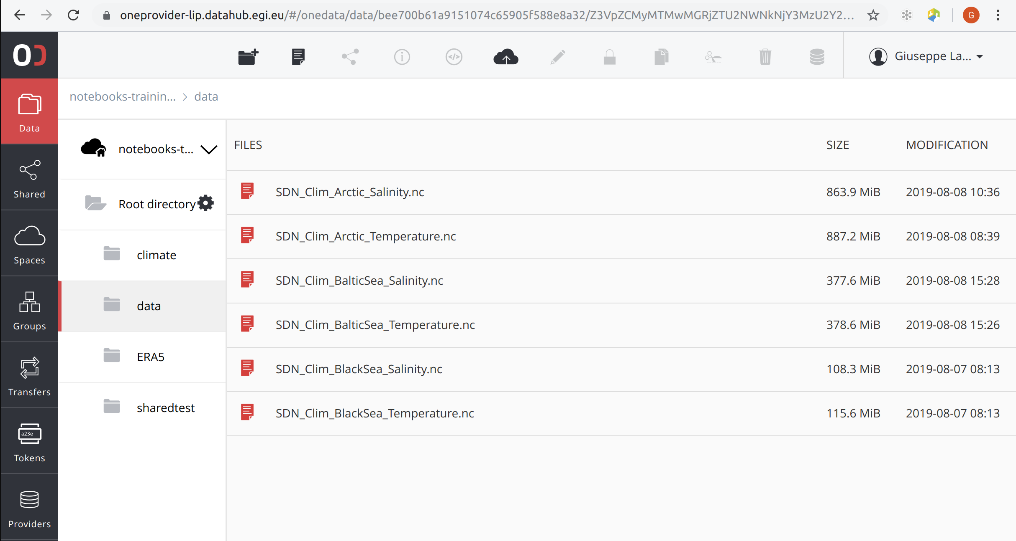
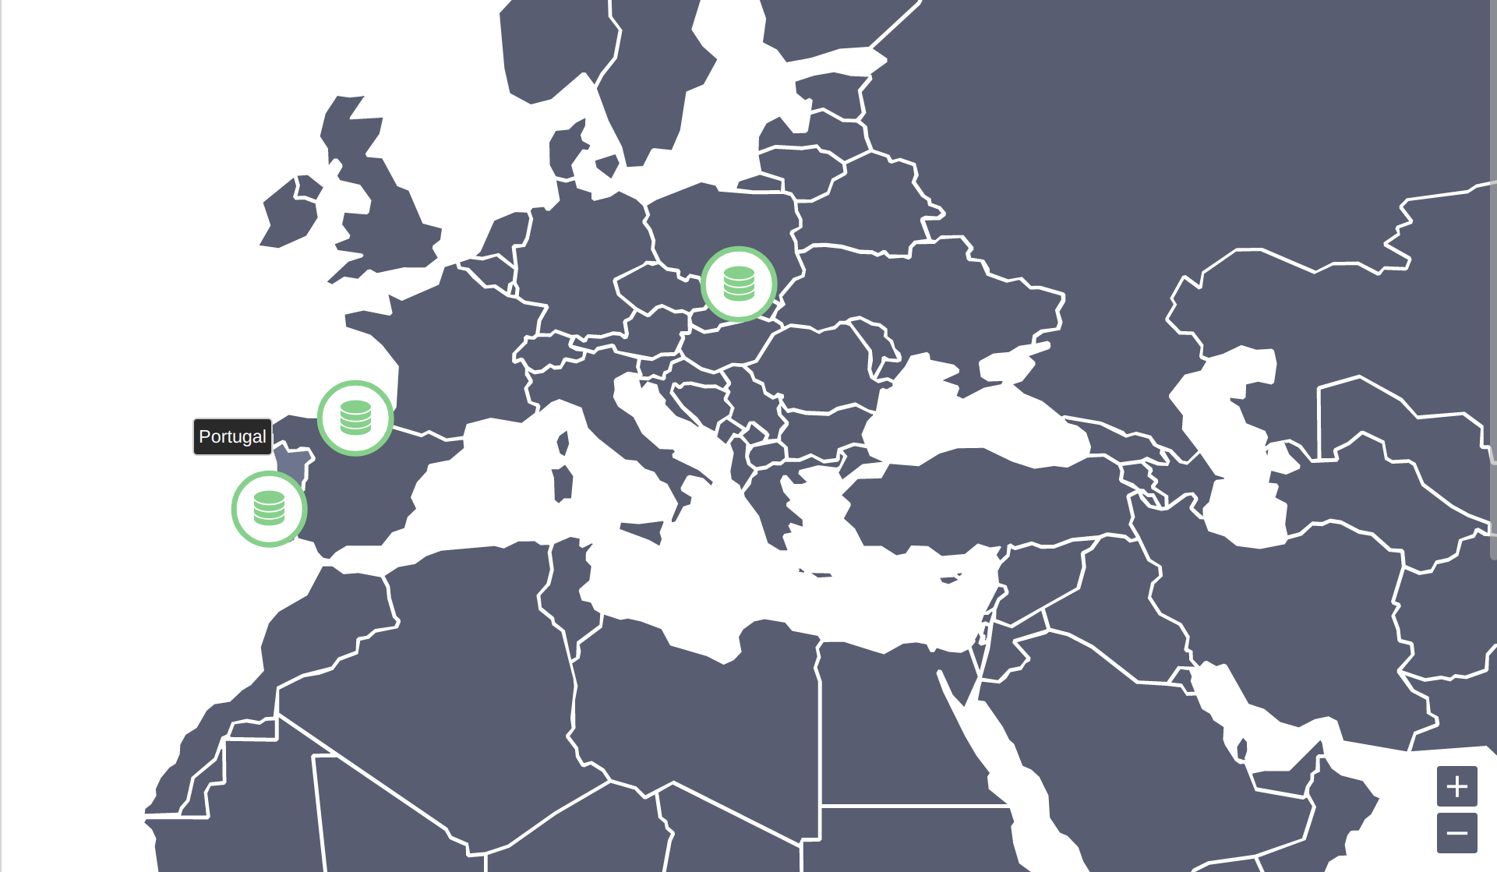
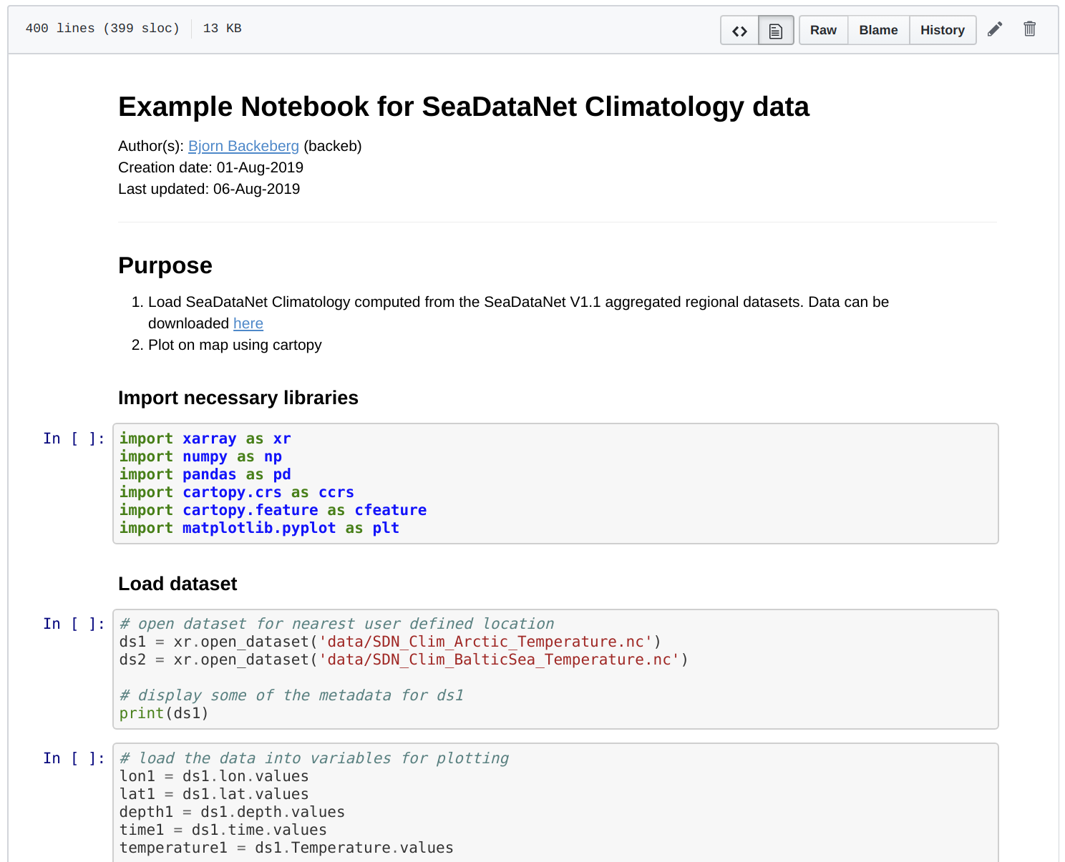
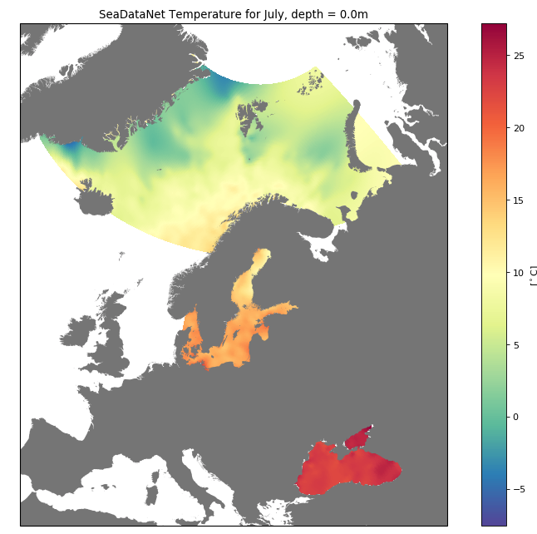
SeaDataNet climatology data
Load SeaDataNet Climatology computed from the SeaDataNet v1.1 aggregated regional datasets. Data can be downloaded here
Screen capture video:
http://go.egi.eu/notebooksvideo

Slide 18
Thank you!
Experience it at https://notebooks.egi.eu
Next ‘reproducible analytics’ tutorial:
Big Data 2019 Conference, Vaxjö, SE
December 04-06, 2019

